Slide 1
Tripster
Your trip collaborator

Slide 2



Teams
Iffah
Wildan
Indra

Slide 3
Contents
Executive Summary
Background
Objective
Architecture
Core Code & Demo
Executive Summary | Background | Objective | Architecture | Core Code & Demo

Slide 4







Trip announcement among close friend based on web service
Many people in a circle has their own plan for trip, some of the plan will be better to do together.
2
3
1
Roles In the TRIP
Basic Requirement
Planning Interface
Tripster
Our trip announcer
Using MySQL
Using NodeJS ejs style
Using HTML, AgnularJS, CSS and bootstrap
Executive Summary | Background | Objective | Architecture | Core Code & Demo

Slide 5

Background
With 20 people, the possibility of trips enormous.
Executive Summary | Background | Objective | Architecture | Core Code & Demo

Slide 6

Background
However, some prefer to join a planned trip
Executive Summary | Background | Objective | Architecture | Core Code & Demo

Slide 7

Background
while some other prefer to make the plan and offer anyone to join
Executive Summary | Background | Objective | Architecture | Core Code & Demo

Slide 8
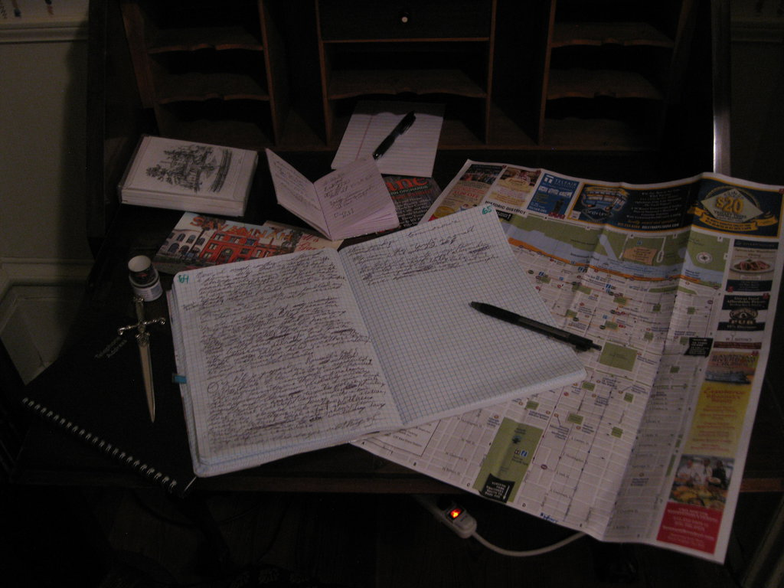
Objective
Manage trip : all member know trip schedule
Executive Summary | Background | Objective | Architecture | Core Code & Demo

Slide 9

Objective
Have more experience visiting many place in Korea
Executive Summary | Background | Objective | Architecture | Core Code & Demo

Slide 10

Objective
Spend time together, team building : make the best teamwork
Executive Summary | Background | Objective | Architecture | Core Code & Demo

Slide 11
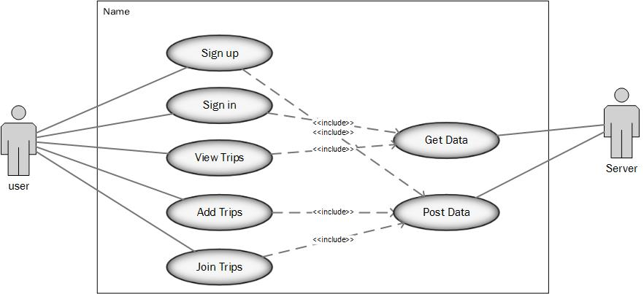
Use Case Diagram
Executive Summary | Background | Objective | Architecture | Core Code & Demo

Slide 12
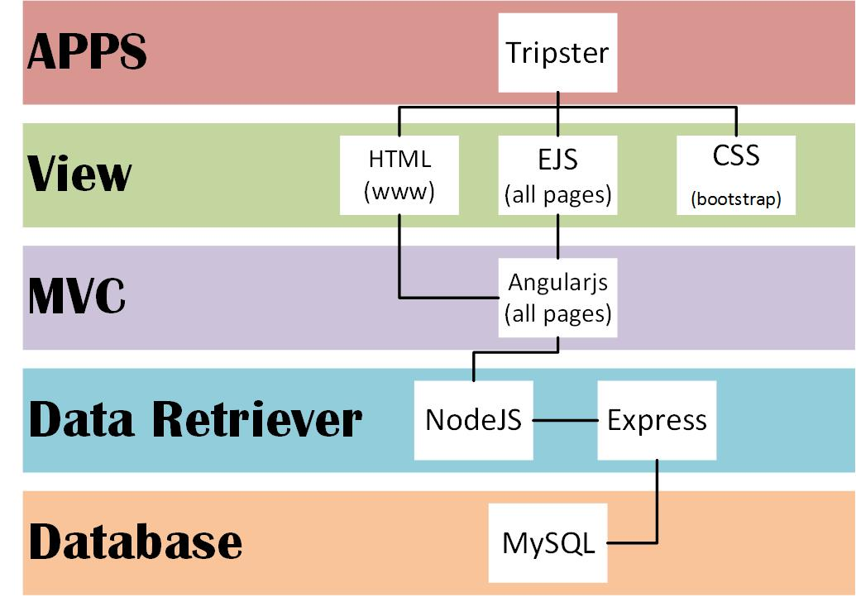
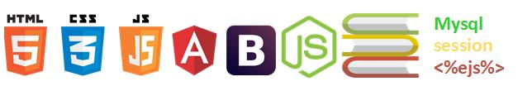
Development Environment
Executive Summary | Background | Objective | Architecture | Core Code & Demo

Slide 13
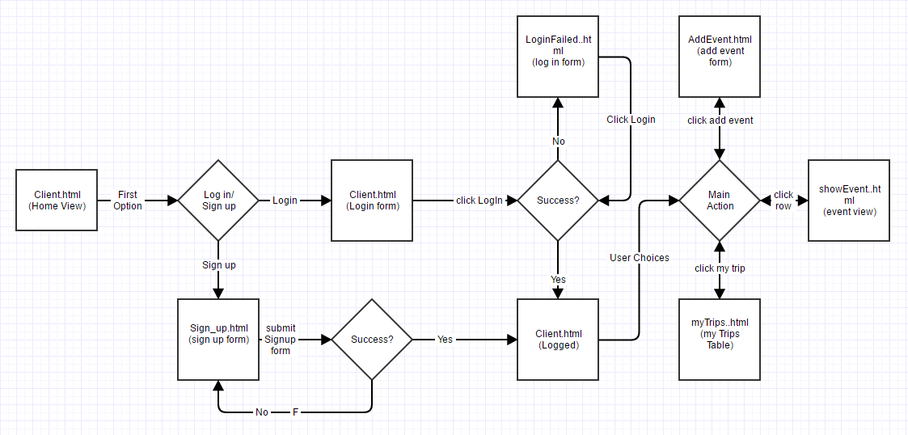
Site Sequence
Executive Summary | Background | Objective | Architecture | Core Code & Demo

Slide 14
Data Relational
userlist
id
username
password
email
phonenumber
followerlist
eventid
follower
eventlist
eventid
creatorid
destination
description
date
Executive Summary | Background | Objective | Architecture | Core Code & Demo

Slide 15
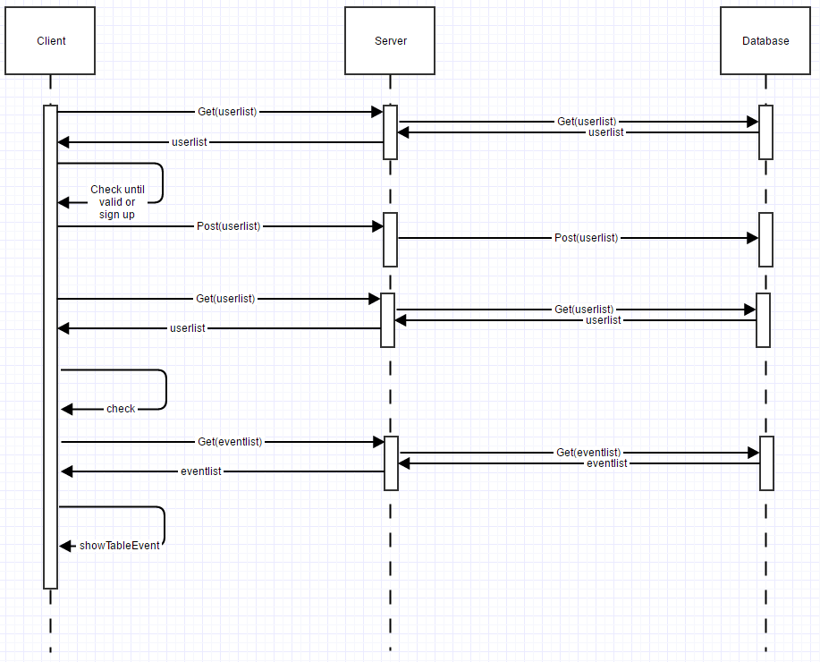
Sequence Diagram 1
Executive Summary | Background | Objective | Architecture | Core Code & Demo

Slide 16
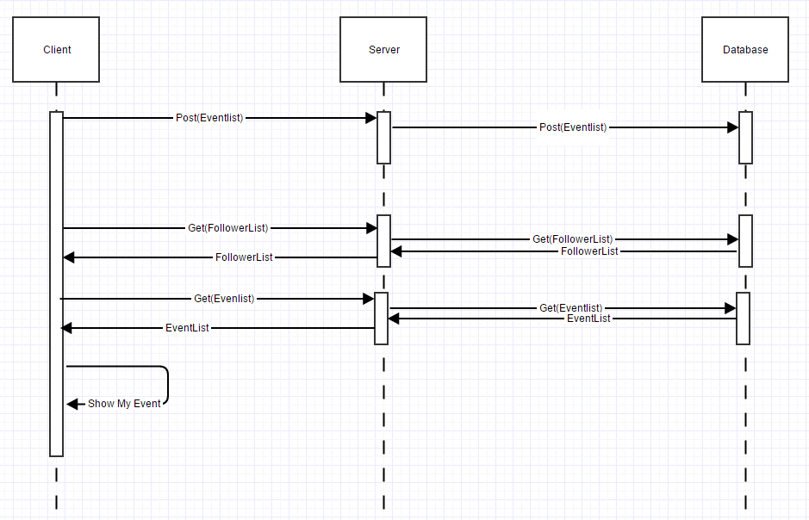
Sequence Diagram 2 add and show event
Executive Summary | Background | Objective | Architecture | Core Code & Demo

Slide 17
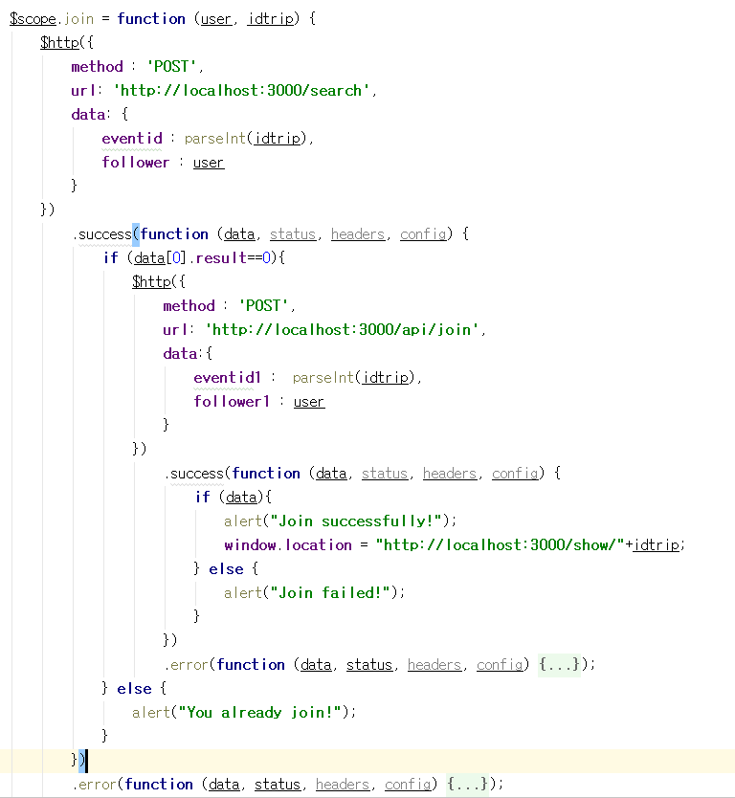
Core Code
Executive Summary | Background | Objective | Architecture | Core Code & Demo

Slide 18
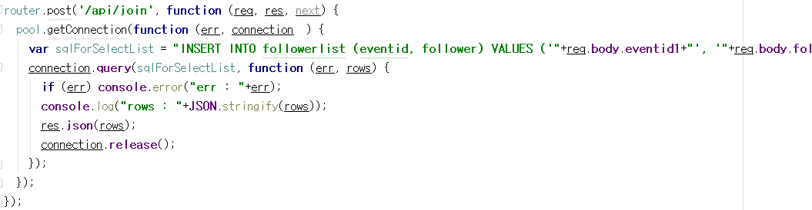
Core Code
Executive Summary | Background | Objective | Architecture | Core Code & Demo

Slide 19
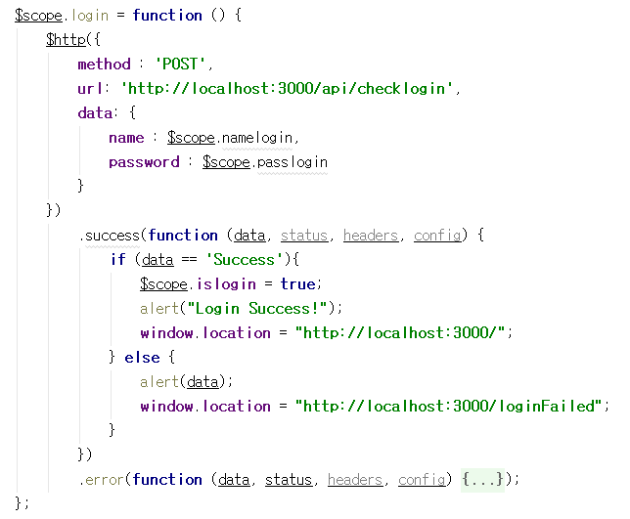
Core Code
Executive Summary | Background | Objective | Architecture | Core Code & Demo

Slide 20
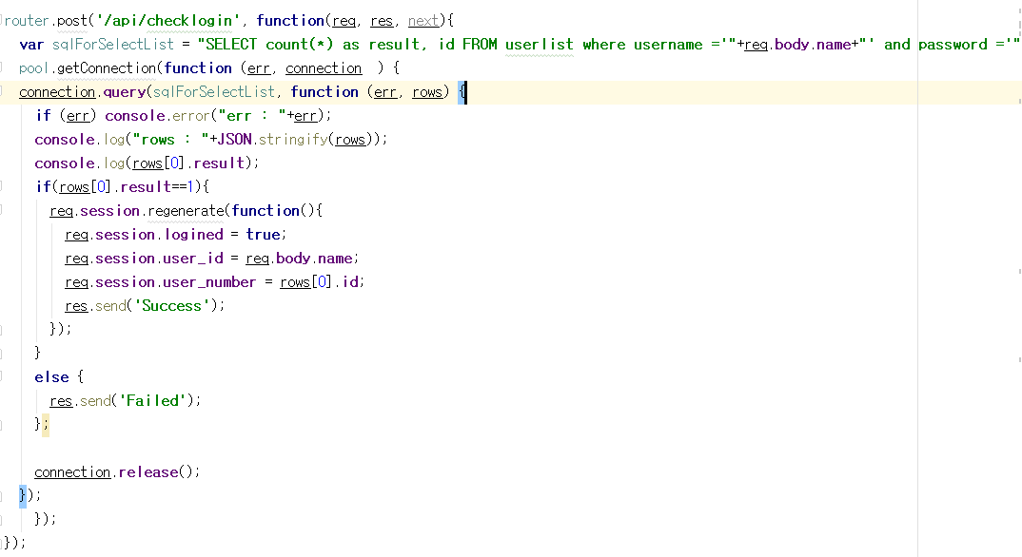
Core Code
Executive Summary | Background | Objective | Architecture | Core Code & Demo

